Slide 1

www.imerygroup.com
Green Building Programs
SILVER LAKES, MADISON, GA - LEED FOR HOMES

Slide 2
Agenda
Objective
Performance Labels?
What are Green Homes
Green Building Programs
Pillars of Green Building
Energy Efficiency
Indoor Environment
Resource Efficiency
Third Party Verification
Customers Benefits
Questions

Slide 3
Objective
HERS Index – Home performance Label
Get a general idea of what are the most popular green building programs in our area
  Programs Goals
  Familiarize with Logos
  Programs Core Values
MADISON NEWEST LEED FOR HOME PROJECT
SILVER LAKES

Slide 4
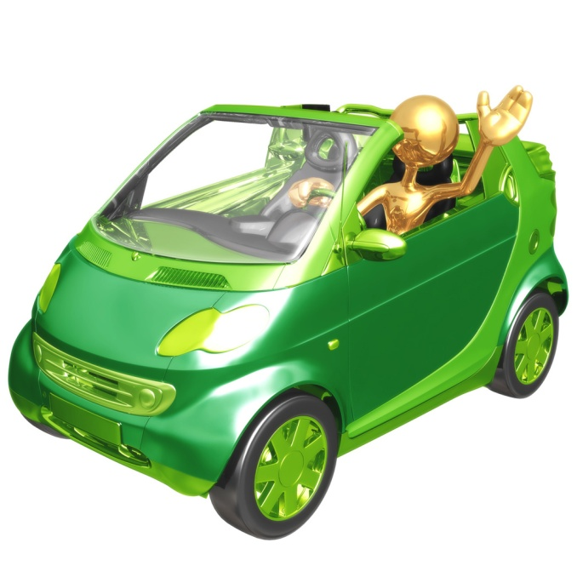
What do you do think when considering buying a car?
Style
Size
Color
MPG’s!!!

Slide 5
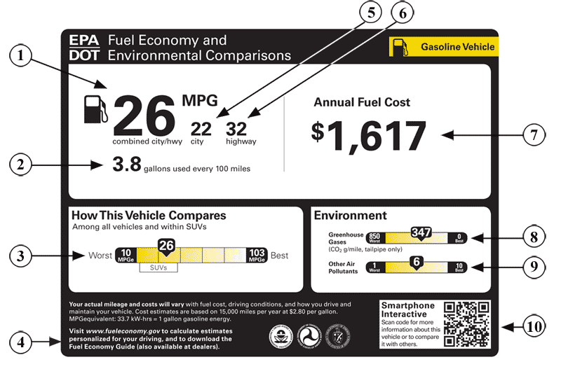
MPG = Energy Label on Automobile Industry

Slide 6
How about when buying an appliance?
Style
Size
Color
Efficiency!!!

Slide 7
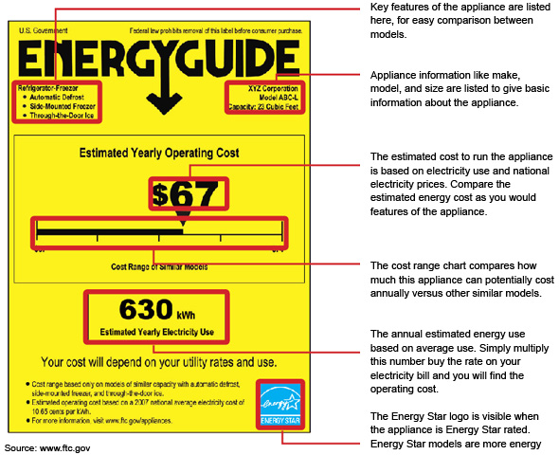
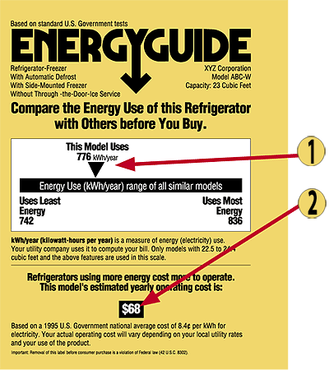
ENERGYGUIDE for appliances

Slide 8

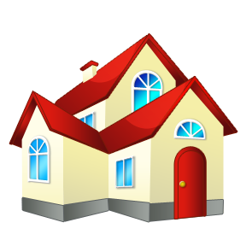
How about an ENERGY LABEL for homes?

Slide 9
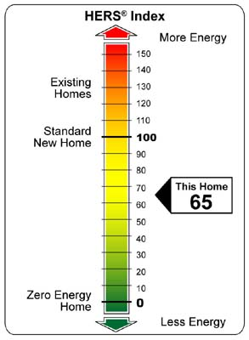
HERS Index
The industry standard by which a home’s energy efficiency is measured.
Developed by RESNET and is the nationally recognized system for inspecting and calculating a home’s energy performance.
BETTTER
In short, a HERS index is the measuring stick for which all new homes & existing homes can be rated

Slide 10
Green Homes ?
HEALTHY , DURABLE, EFFICENT AND COMFORTABLE
  Third Party Verified
  At least two inspection done through construction process, including air leakage tests
  Outperforms a code build home in terms of performance, at least 15% more efficient

Slide 11
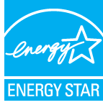
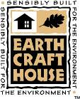

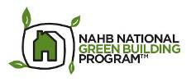
Most Popular Green Building Programs
ENERGY STAR ® :Government backed program developed by EPA, DOE and Private Business
EarthCraft House: Is a partnership between the Greater Atlanta Home Builders Association, Southface Energy Institute, the government and industry partners
LEED for Homes: Developed by the U.S Green Building Council ( USGBC )
Developed by National Association of Home Builders ( NAHB ) and the International Code Council (ICC) . Program also known as ICC 700 National Green Building Standard™ which receive approval from the American National Standards Institute (ANSI).

Slide 12
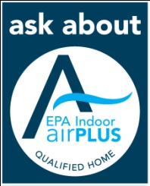
Pillar of Green Building
Step 3
Up to 30-50% of green building point systems are related to energy efficiency
Resource
Efficiency
Step 2
Step 2
Indoor
Environment
Site Planning
Water
Materials
Waste Mgt.
Renewables
Step 1
Energy
Efficiency
Bulk Moisture
Radon
Pest Control
HVAC
Combust. Safety
Materials
Commissioning
Envelope
Distribution
Equipment
Lighting
Appliances

Slide 13
Why Energy Efficiency
70% of energy use goes to heat and cool our home’s air & water.
Just focusing in reducing our energy consumption alone will substantially reduce our impact on the planet.

Slide 14
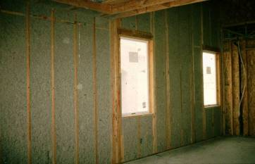
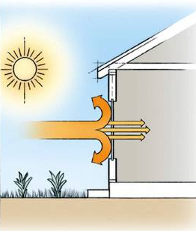
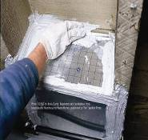
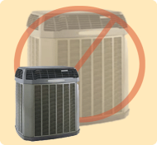

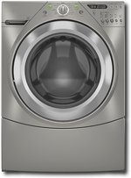
Achieving Energy Efficiency
Effective Insulation
Tight Construction and Ducts
High Performance
Windows
Efficient Equipment
Lighting and Appliances

Slide 15
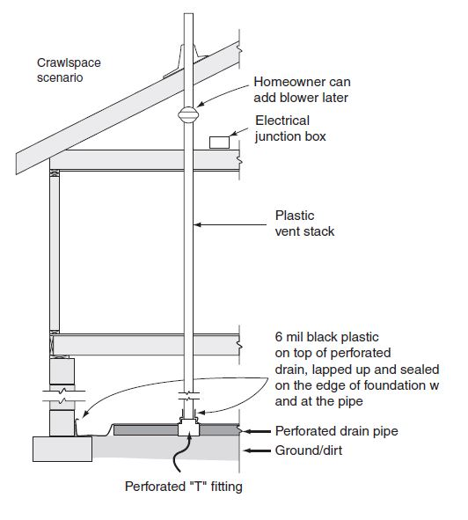
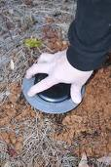
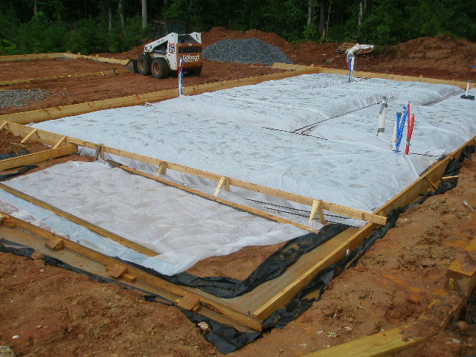
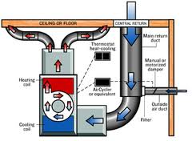
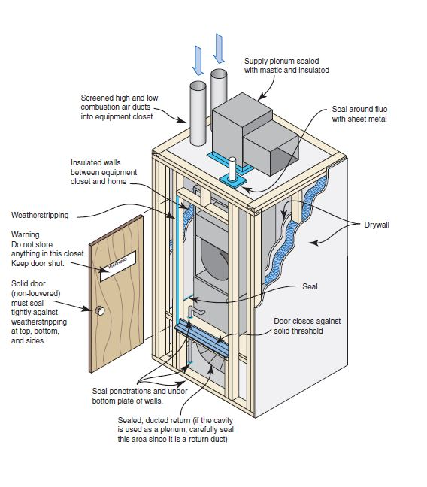
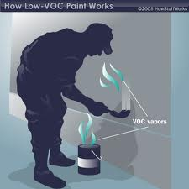
Indoor Environment
Moisture Control
Radon
Pest Control
HVAC System – Fresh Air
Materials
Combustion Safety

Slide 16
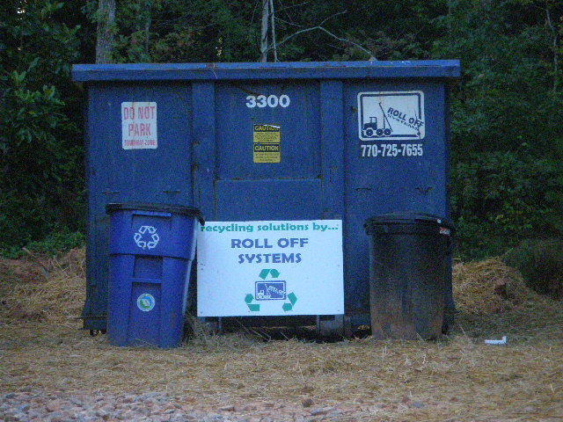
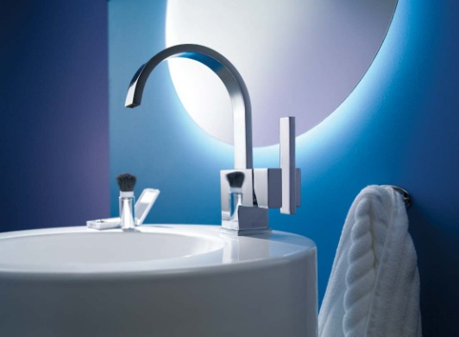
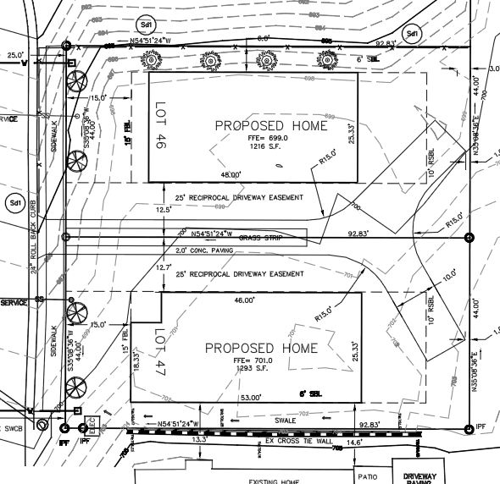
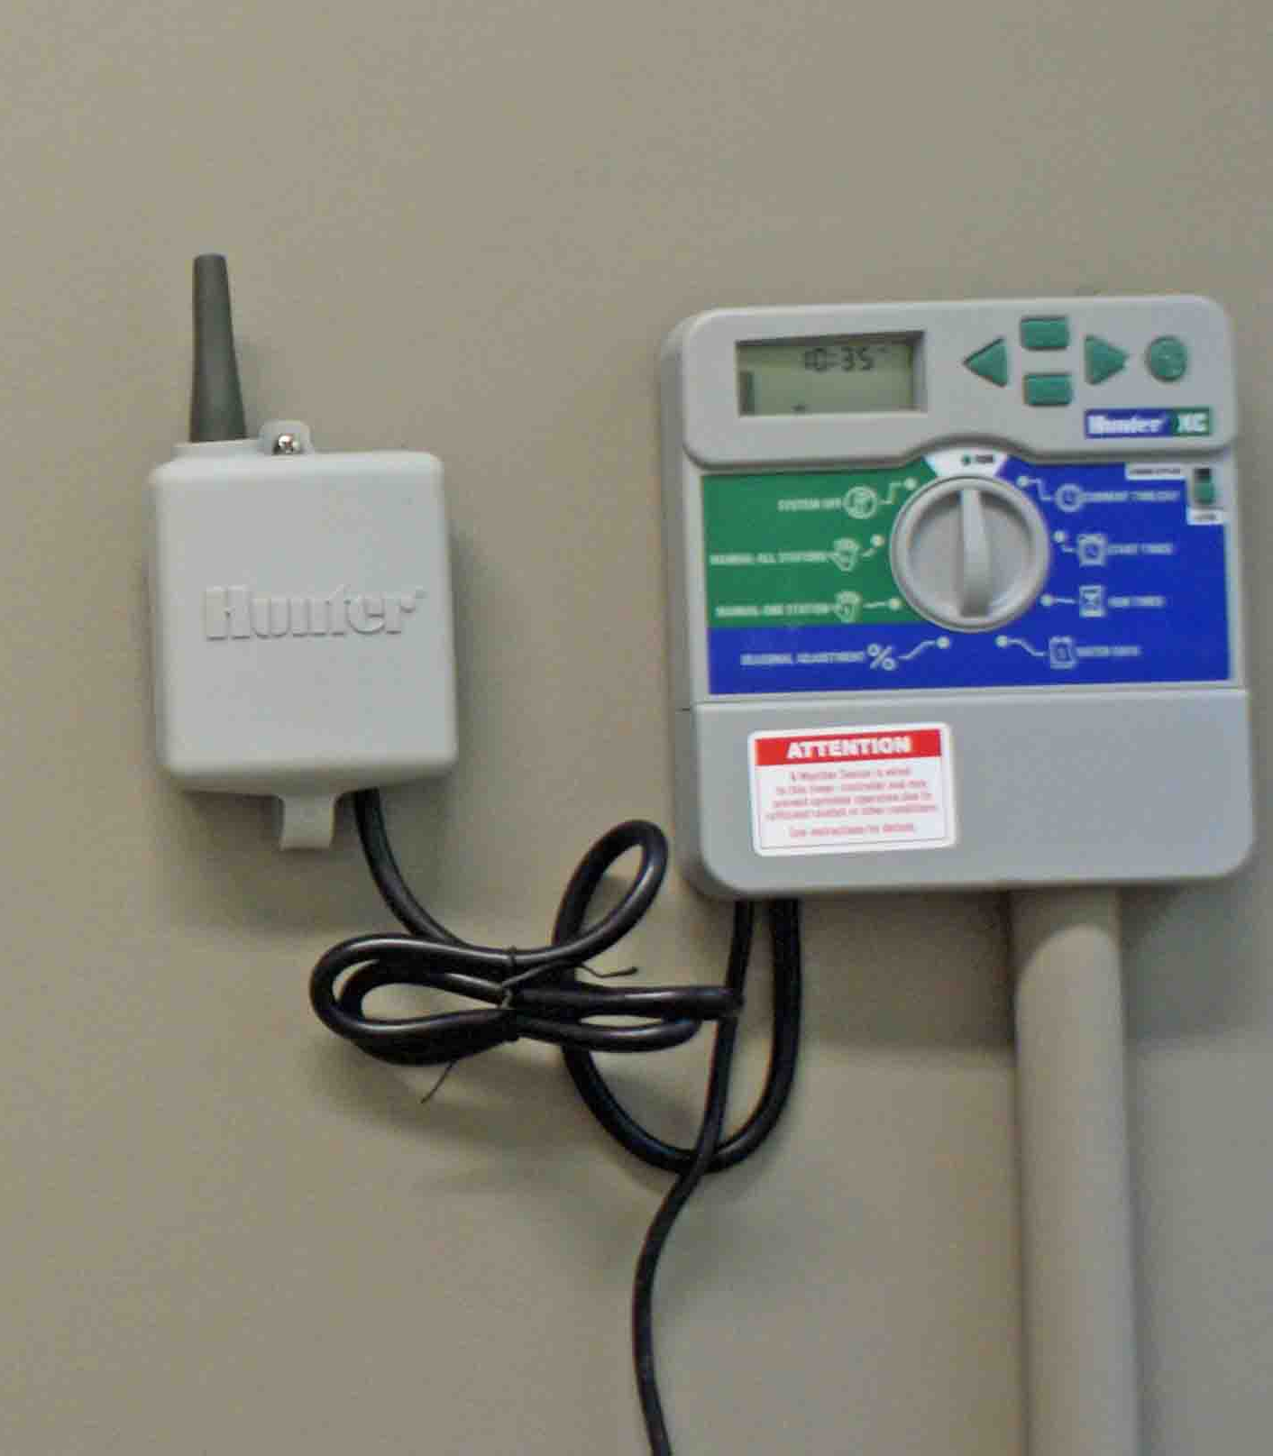
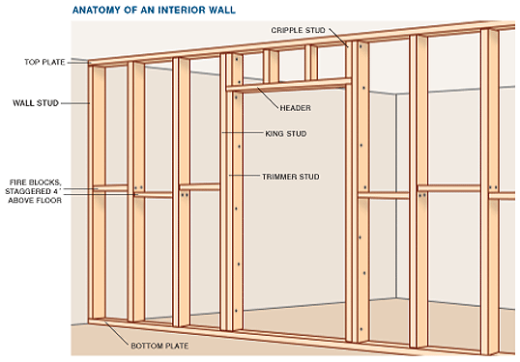
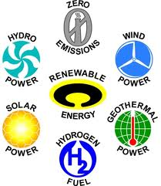
Resource Efficiency
Site Planning
Waste Management
Indoor Water Use
Outdoor Water Use
Materials
Renewable

Slide 17
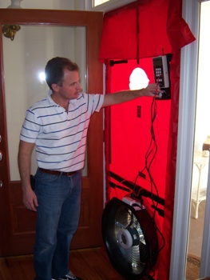
Third Party Verification
Energy Model / Hers Index < 85
Pre-drywall Inspection
Final Inspection
Building Envelope leakage test
Duct leakage test

Slide 18
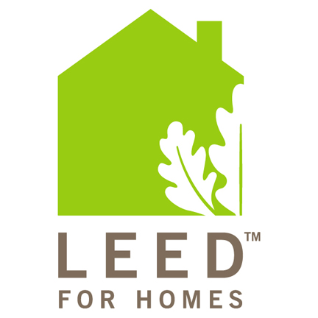

LEED FOR HOMES

Slide 19
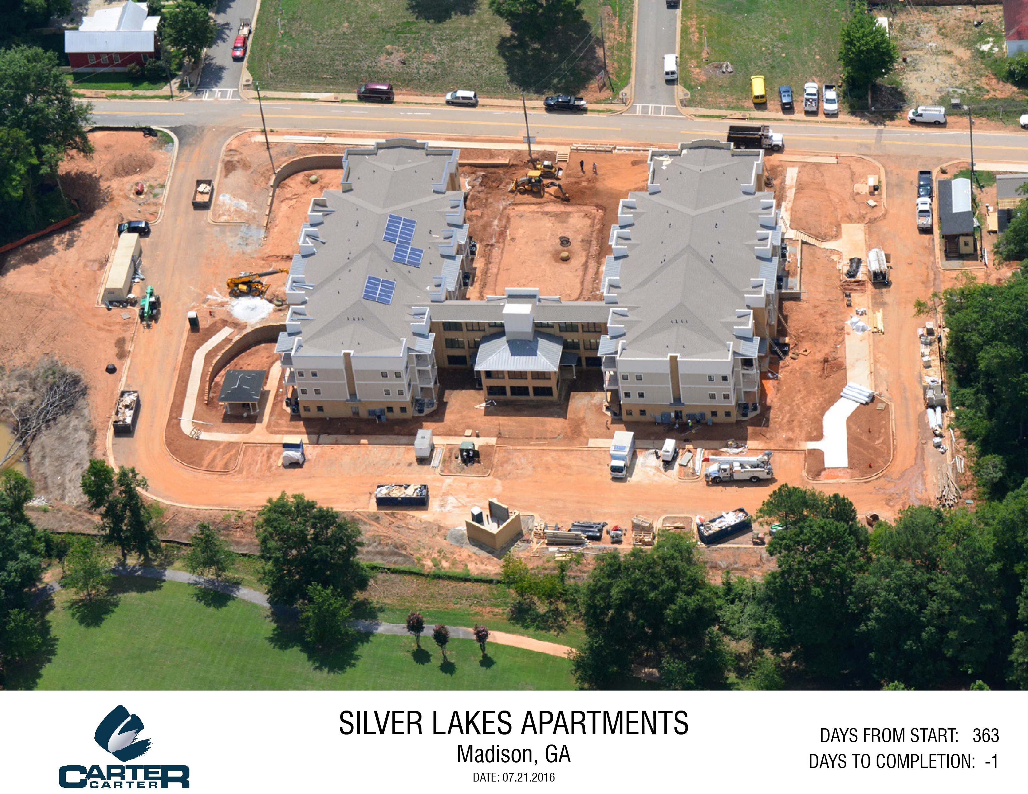
SILVER LAKES

Slide 20
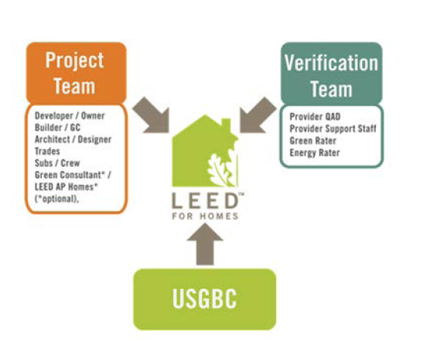
TEAM ROLES

Slide 21
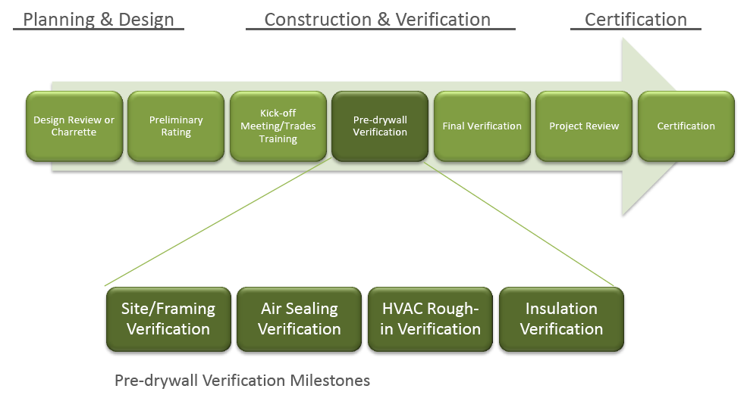
CERTIFICATION TIMELINE

Slide 22
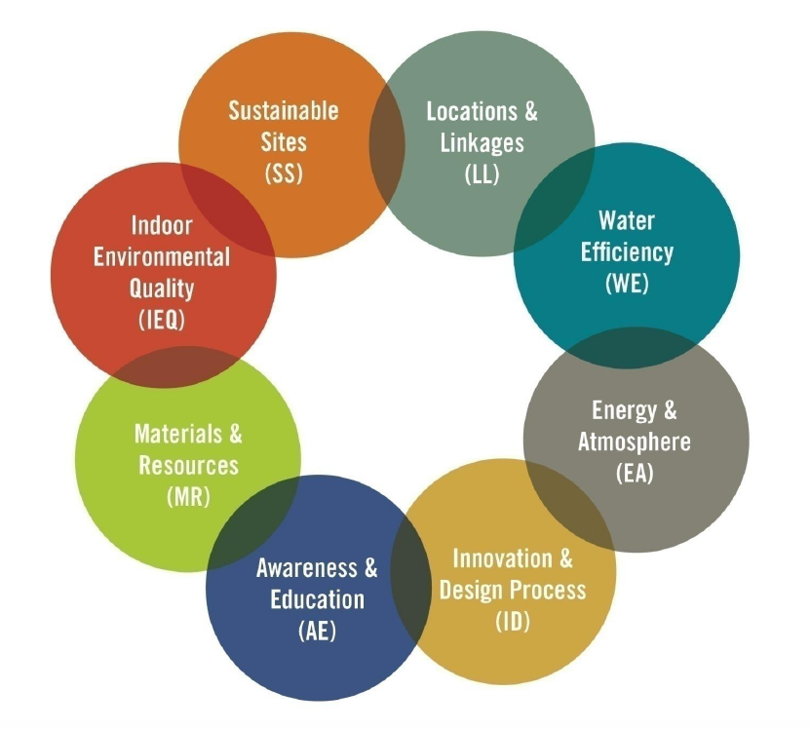
CREDIT CATEGORIES

Slide 23
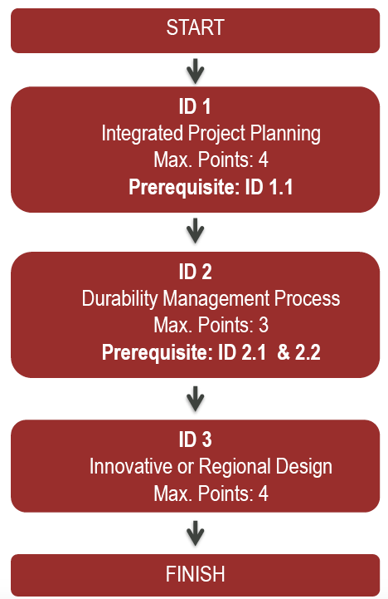
INNOVATION AND DESIGN

Slide 24
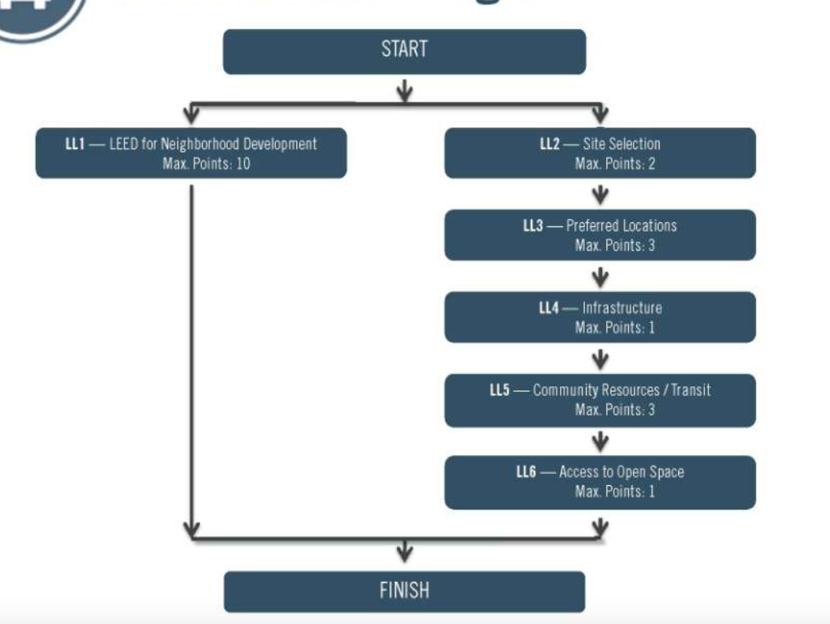
LOCATION & LINKAGE

Slide 25
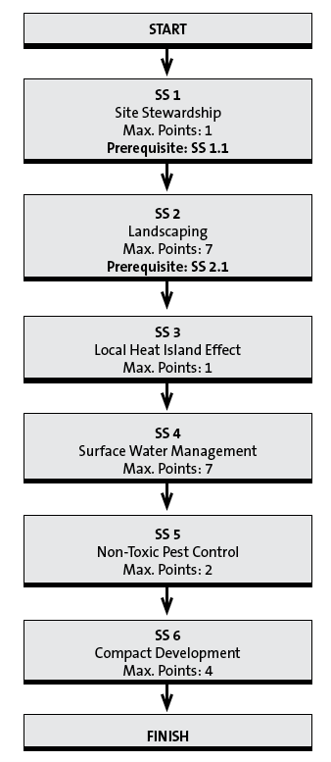
SUSTAINABLE SITES

Slide 26
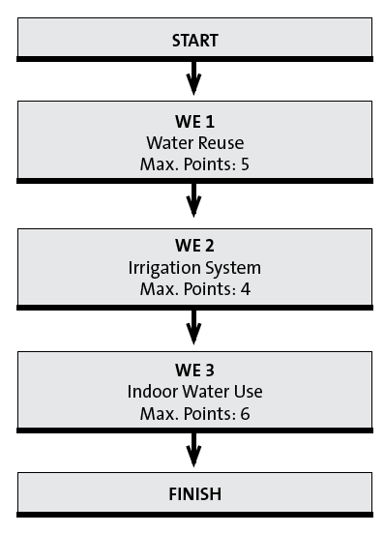
WATER EFFICIENCY

Slide 27
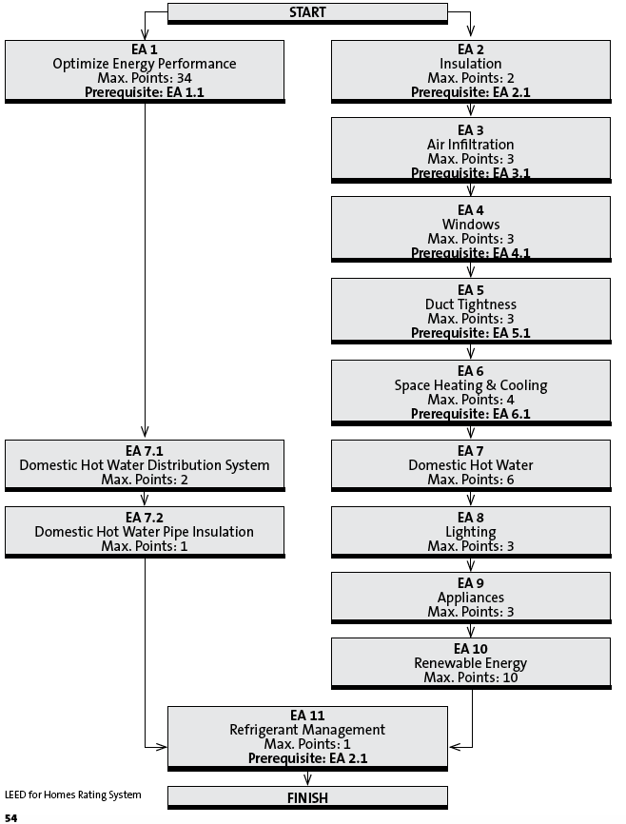
ENERGY & ATMOSPHERE

Slide 28
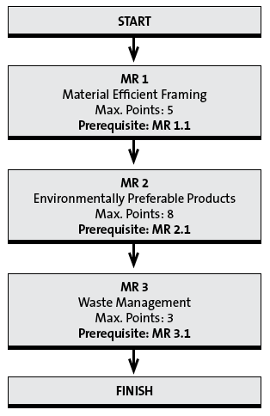
MATERIALS AND RESOURCES

Slide 29
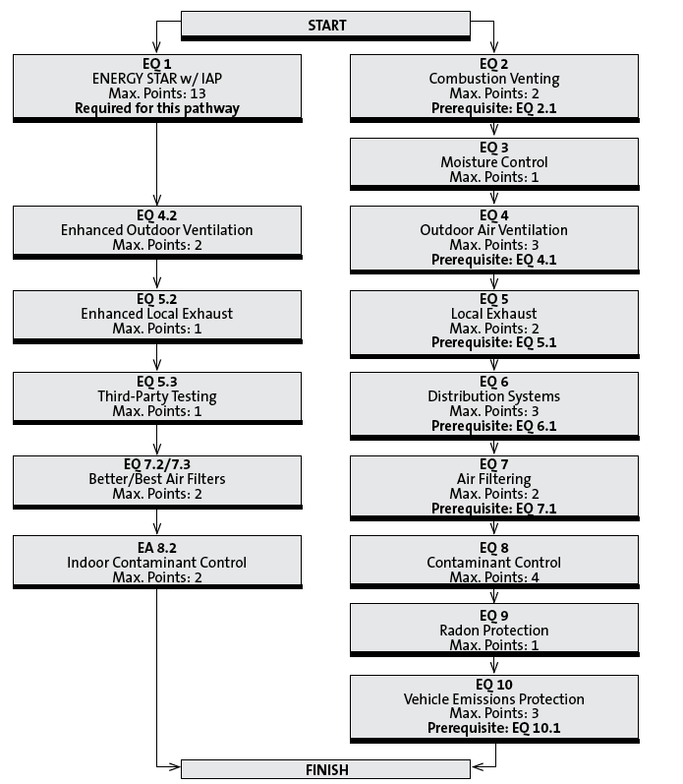
INDOOR ENVIRONMENTAL QUALITY

Slide 30
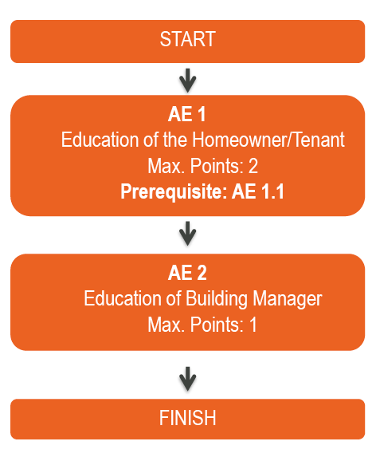
AWARENESS AND EDUCATION

Slide 31
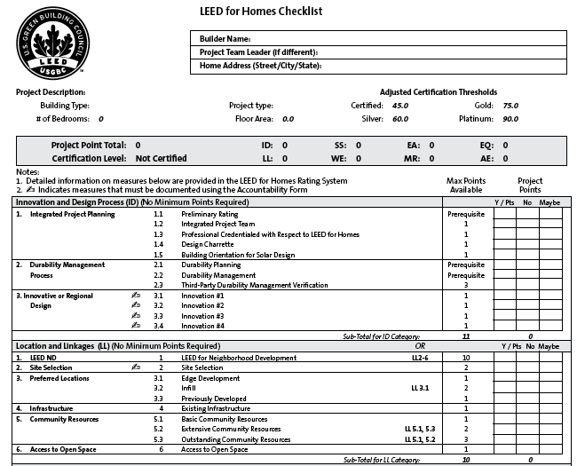
LEED CHECKLIST

Slide 32
THANKS YOU !!!
www.imerygroup.com
Luis Imery –Owner Cell: 770-2941014

